Slide 1

Scaling up treatment in resource-constrained settings:
What will it take to achieve the last 90?
Gloria Maimela, MBBCh, MBA
University of the Witwatersrand, South Africa
Mexico City, 22 July 2019

Slide 2
Conflict of interest
None to declare

Slide 3

Notes:
Stay at home mom
Discovered her HIV positive status while pregnant with 1st child 24 years ago
No access to PMTCT then
Subsequent 2 pregnancies: Access to PMTCT: HIV Negative children (Nomhle, 16, Musa 19 months)

Slide 4
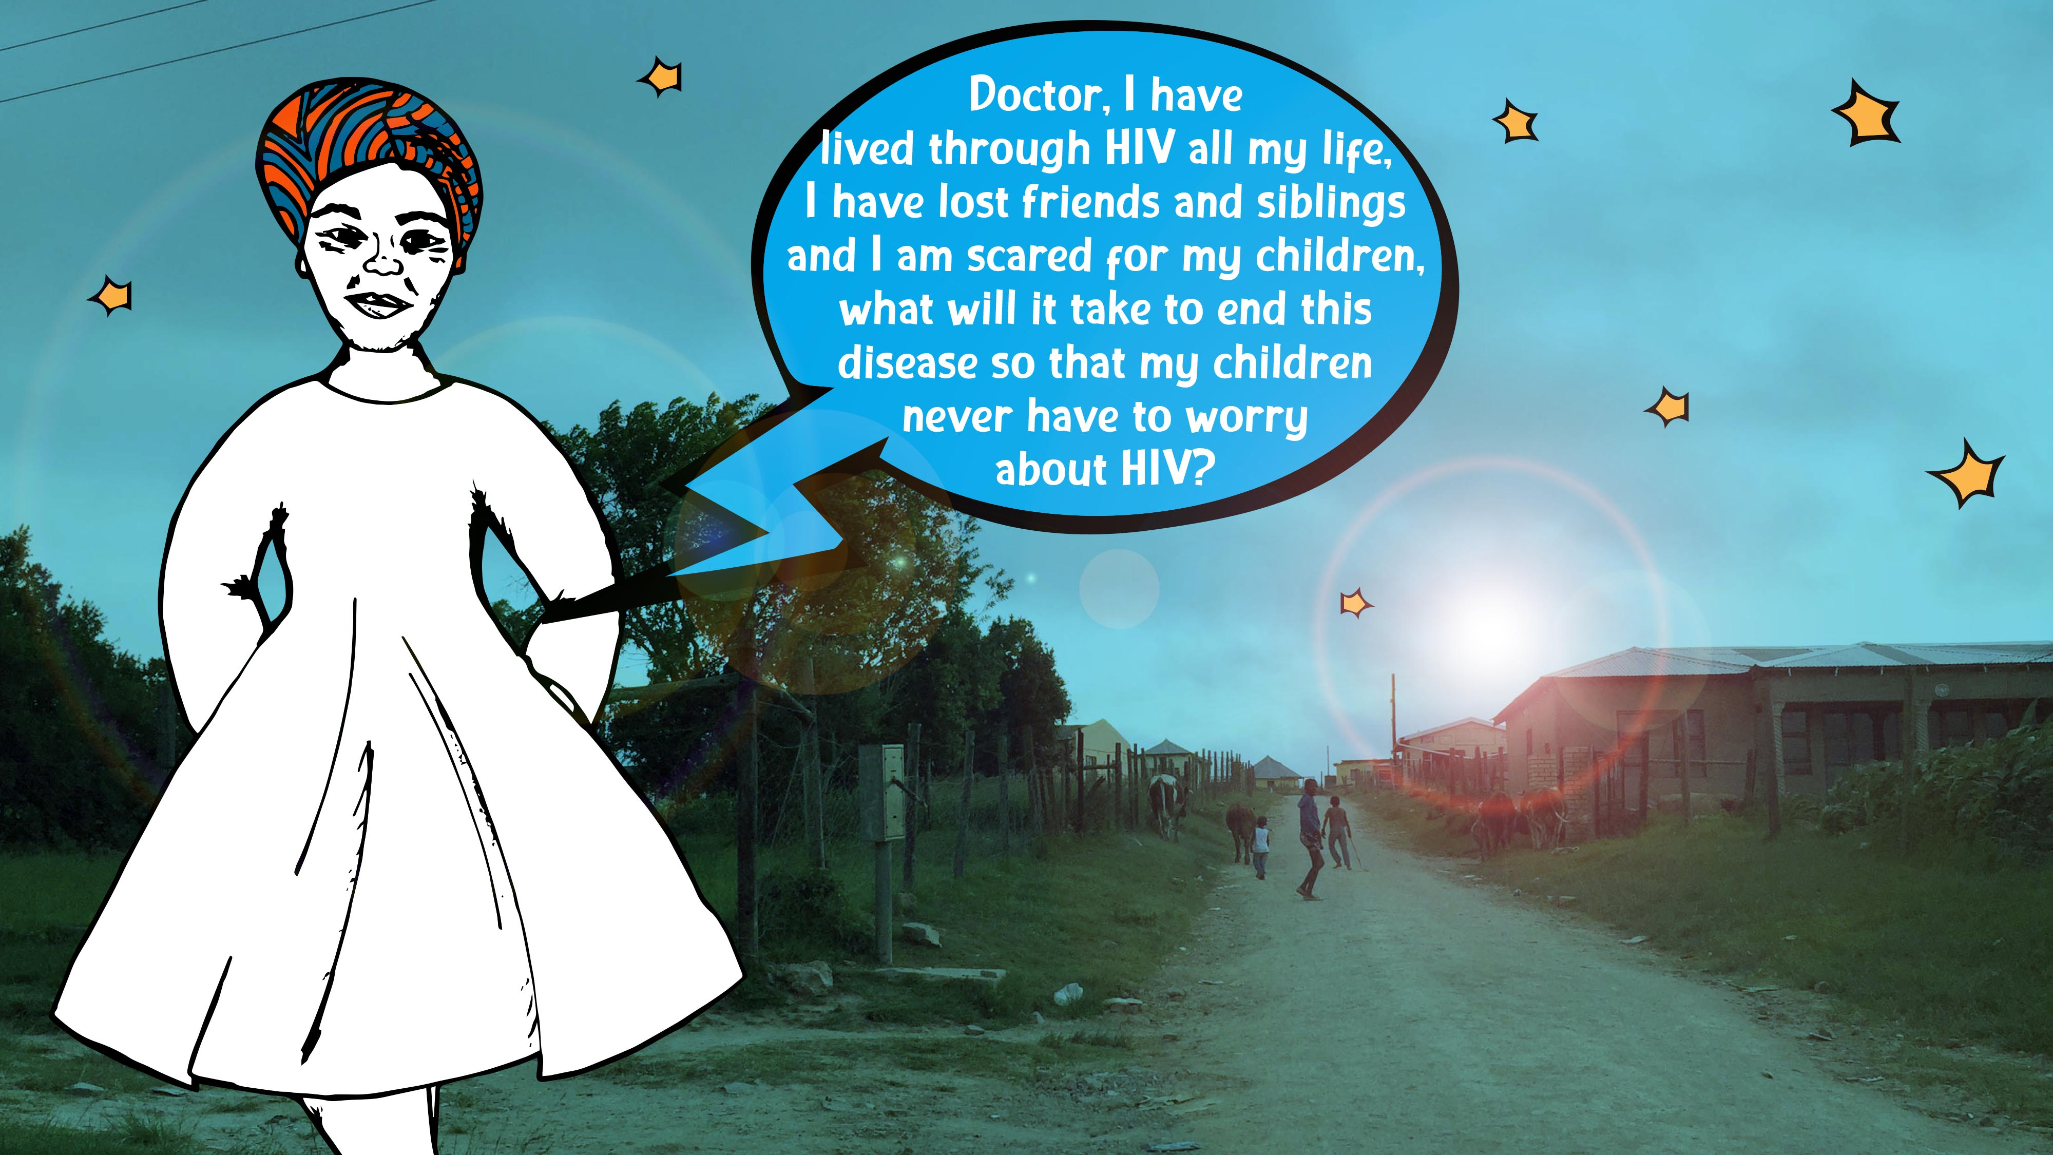



Slide 5
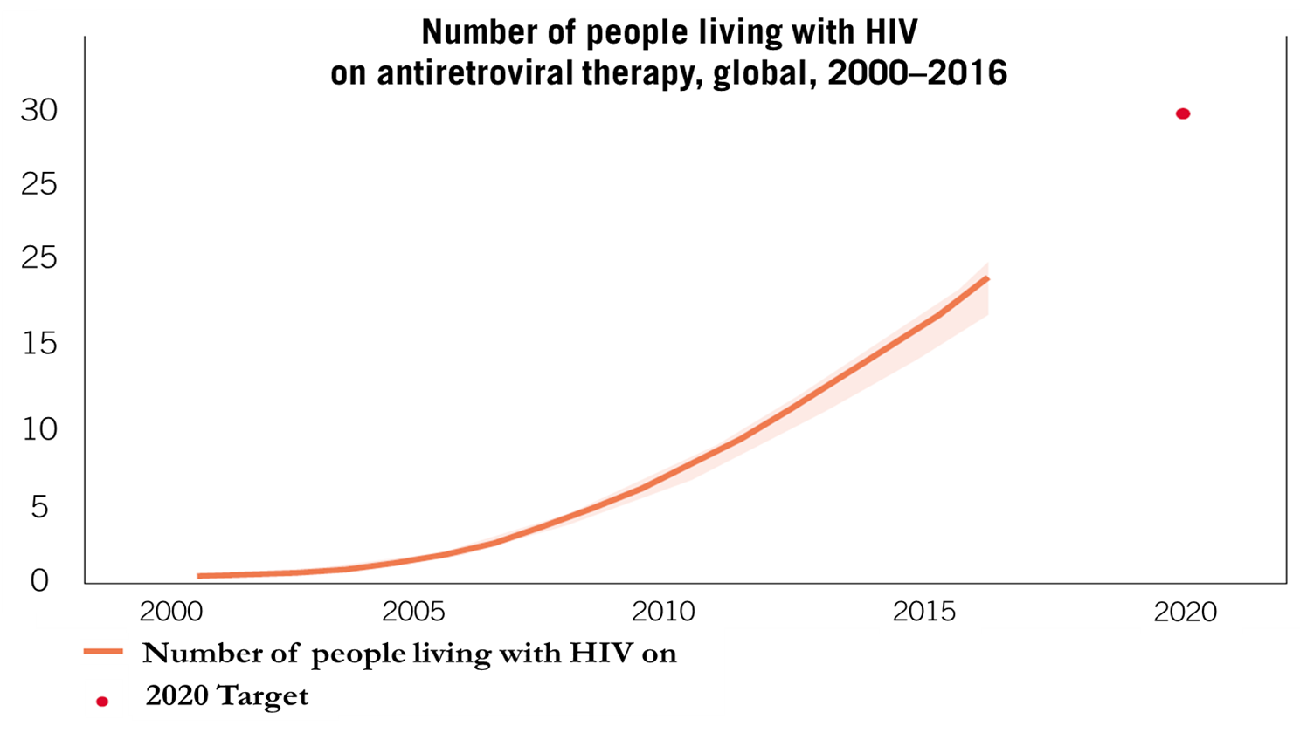
Remarkable progress in scaling up ART
Source: UNAIDS 2018

Slide 6
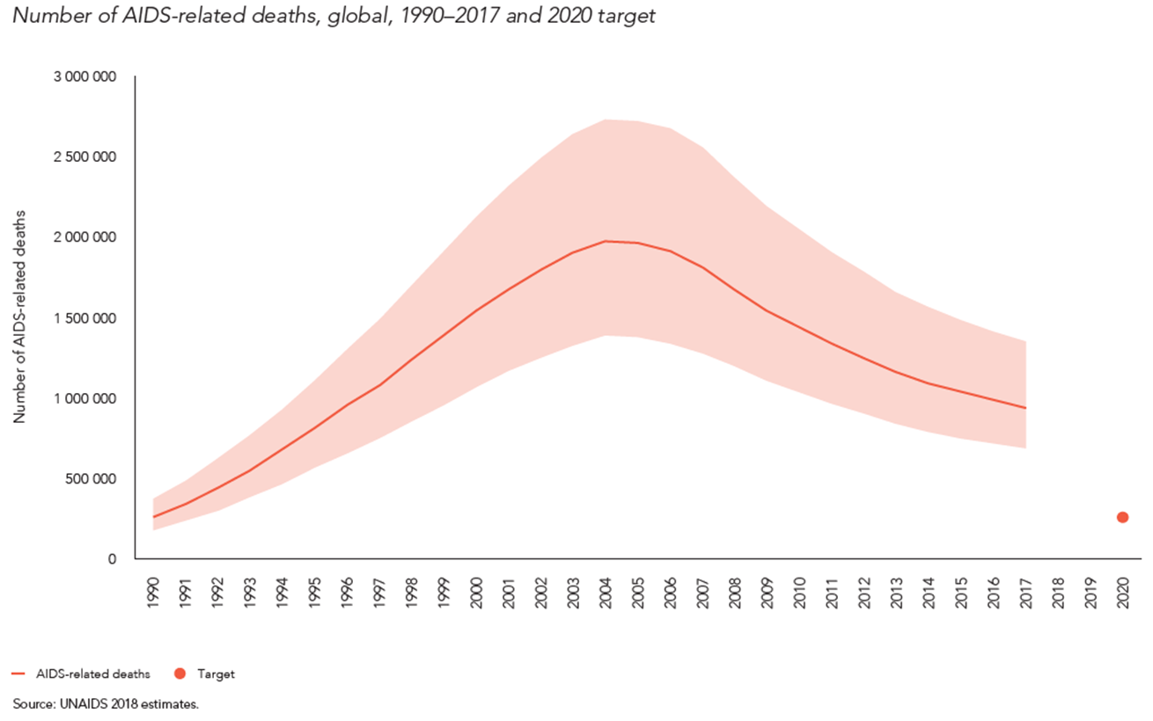
Dramatic declines in death

Slide 7
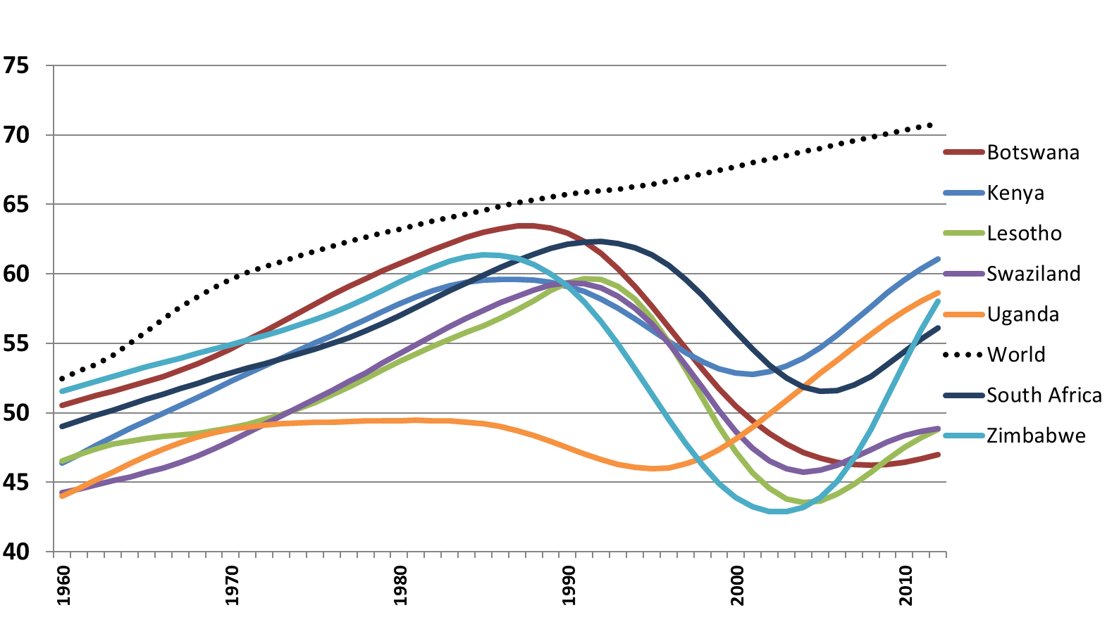
Life expectancy regained
World Bank 2014

Slide 8
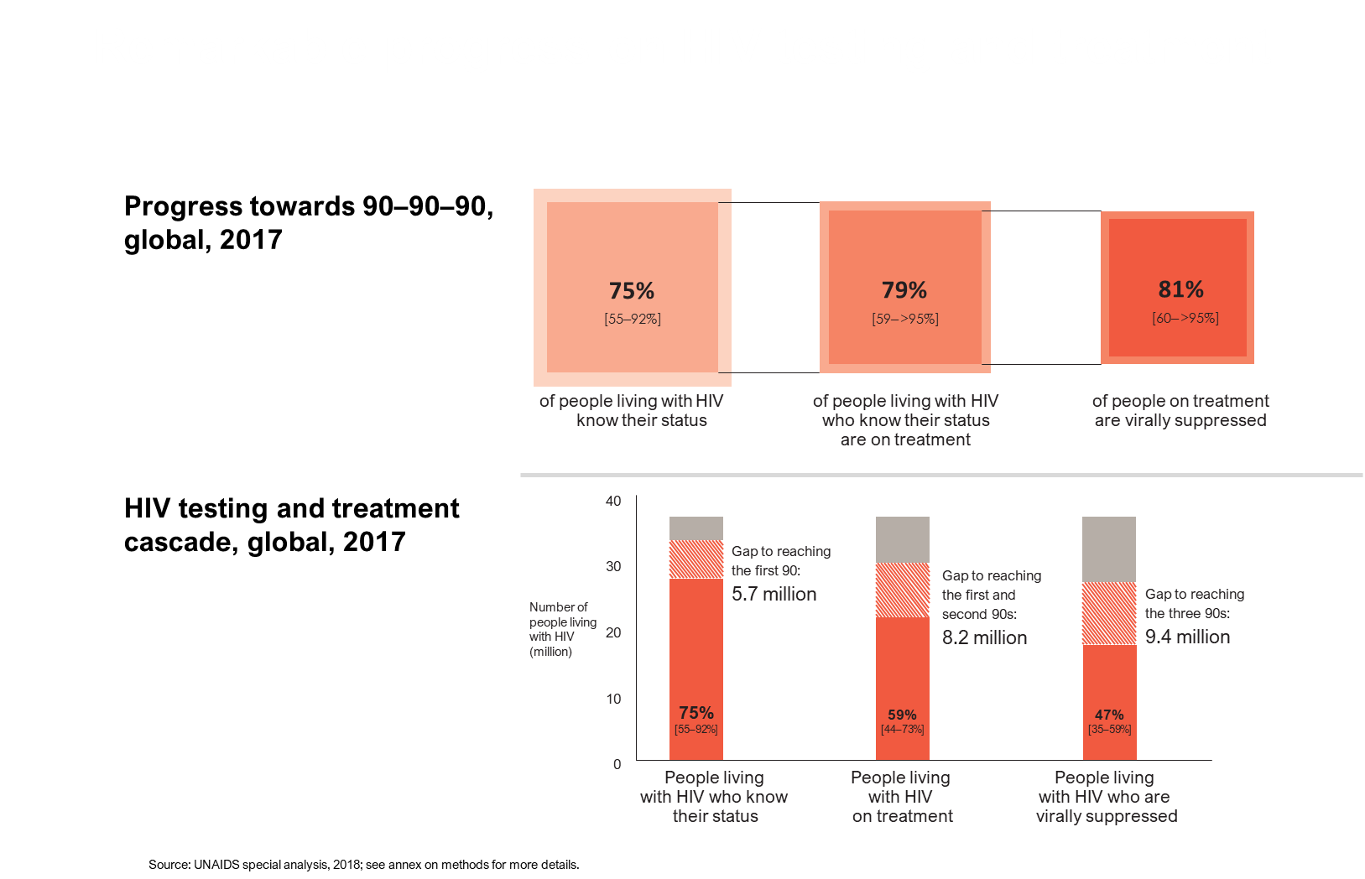
Global progress on 90-90-90, 2017
UNAIDS 90-90-90 Cascade:
Quantify the HIV response globally and at regional level
Focus on who we are missing in the cascade
Recognise that we cannot reach our goal of epidemic control (3rd 90) without addressing preceding steps (1st and 2nd 90)
Source: UNAIDS 2018
Notes:
Talk about the benefits of 90-90-90

Slide 9
Gaps in achieving 2020 targets
Source: UNAIDS 2018

Slide 10
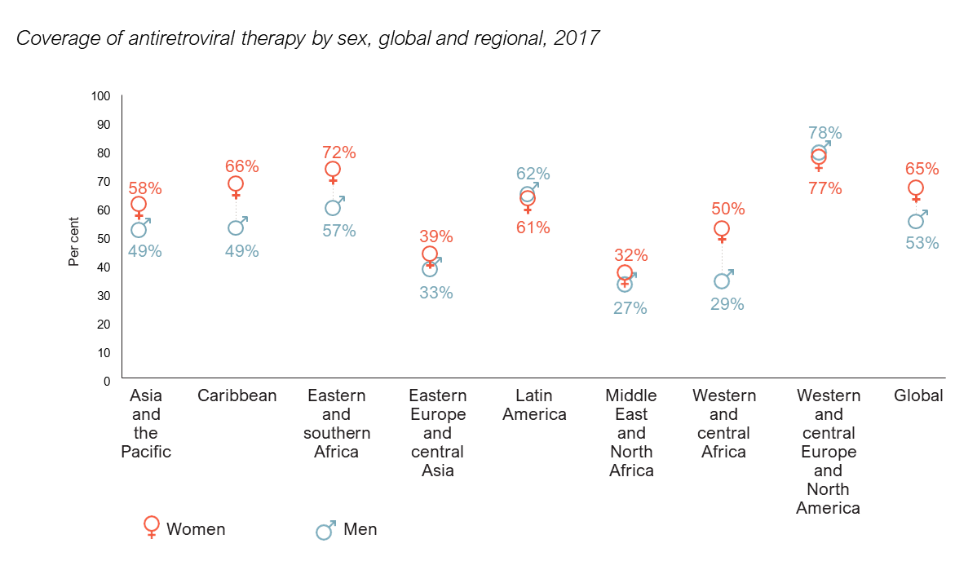
Progress varies
Treatment access
LOWER
Men vs women
MSM
Sex workers
PWUD
Adolescents
Vs. adult populations
Source: UNAIDS 2018
Notes:
By region, age, gender, key populations

Slide 11
Social factors undermine the treatment cascade
e.g. poverty and livelihood factors
HIV testing
Influenced by travel time/distance, lack of consistency and co-ordination across services, and the limited involvement of the community in the programme planning process
Transport costs and distance impeded continuity in HIV care.
Housing instability was a significant predictor of non-adherence to HAART
Transport costs, distance to health facility, food shortage, patient-related time constraints are economic barriers to linkage to care
Unstable housing associated with poor health service utilisation
Viral suppression
ART initiation
Food insecurity is an important barrier to ART adherence and provision of food can improve adherence
Source: Leaver, 2007; Obermeyer, 2007; Posse, 2008; Govindasamy, 2012; de Pee, 2014; HIarlaithe, 2014;Singer, 2015

Slide 12
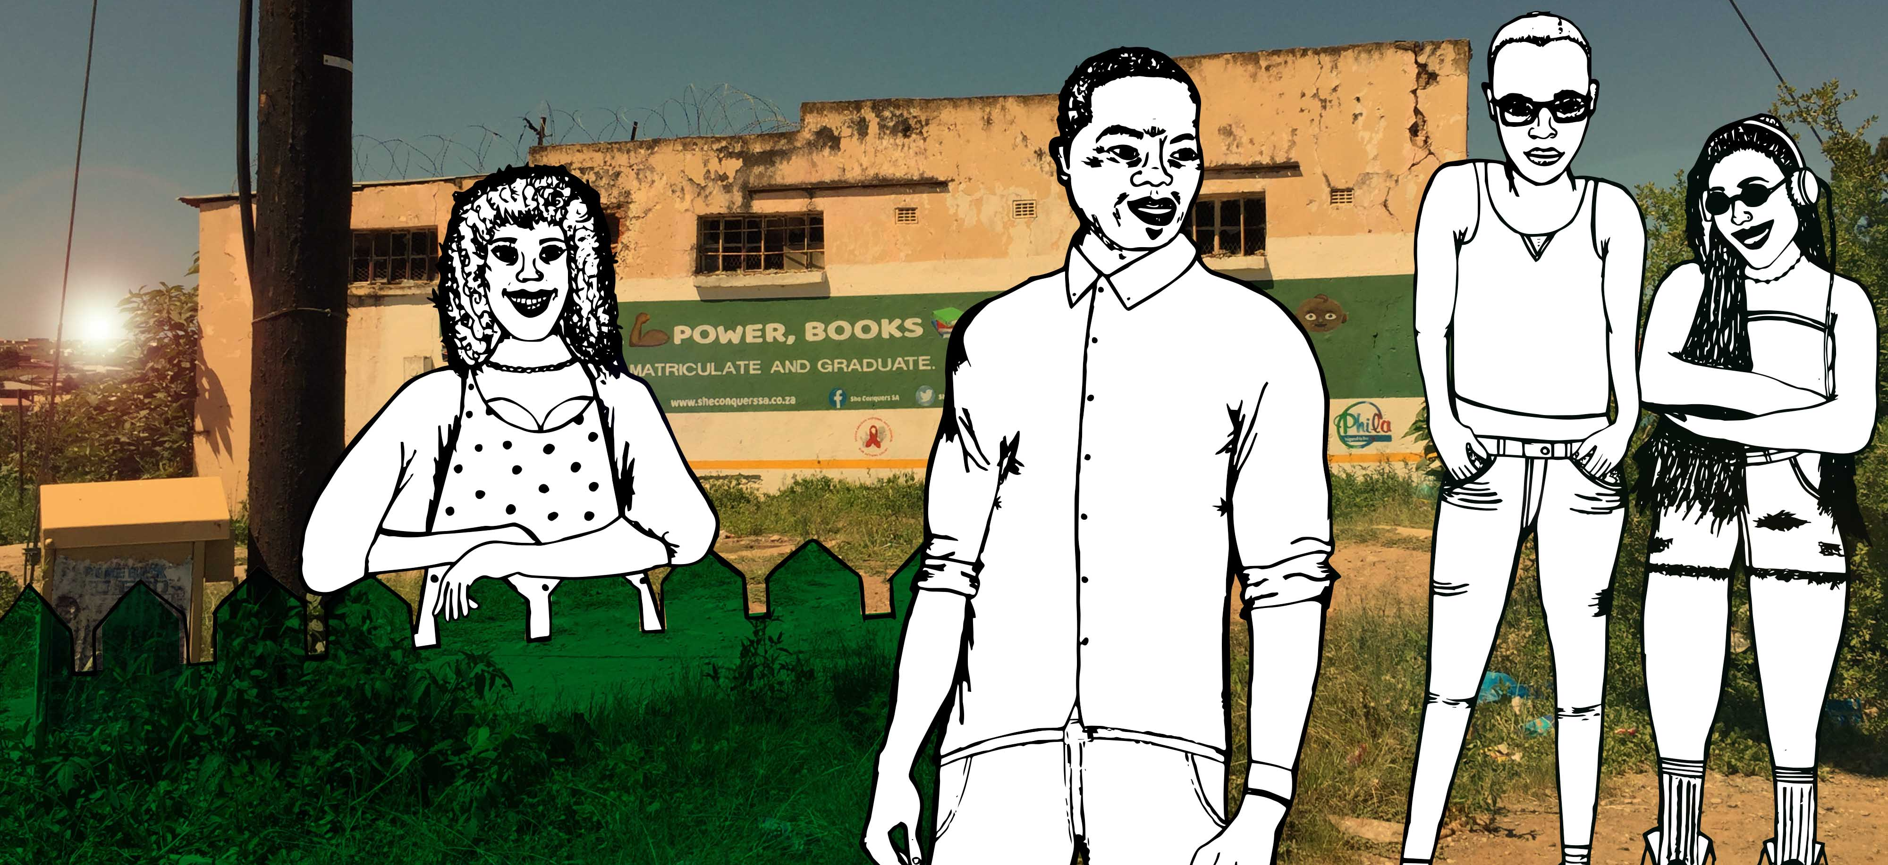
Hard to reach?

Slide 13
Advances in HIV self-testing increase reach
Workplace Distribution: Men, South Africa
Sex Worker Distribution, South Africa
Used
Tested Positive
Attended confirmatory testing
Confirmed Positive
Initiated ART
Source: Majam, personal communication, 2019

Slide 14




Digital engagement: enhancing demand
Video shared via social media in Botswana
#WhyNotToday
VIDEO
34,837 reached
in 1st week
Source: PEPFAR COP19 Outbrief - Botswana

Slide 15
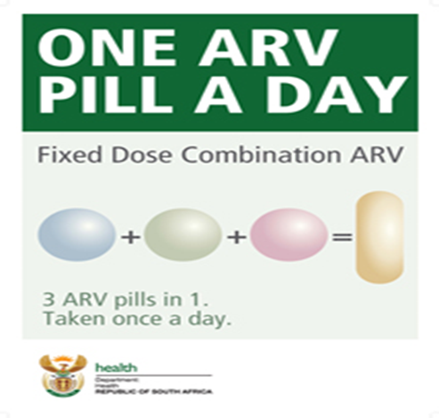
ART initiation simplified
Test and start
Same day initiation
Fixed dose combinations
Same day initiation improves range of ART outcomes
WHO, 2015; Mateo-Urdiales, 2019
Notes:
Rapid ART initiation (within 7 days) leads to improved outcomes across the cascade in LMIC
Better ART uptake at 12 months
Greater viral suppression
May improve retention
Associated with lower mortality
Studies demonstrating these effects delivered rapid ART with other interventions. Emphasises need for pragmatic research to identify feasible delivery packages that assure the effects in trials are realised in programmes

Slide 16


New drugs, new formulations
Past, present…
…and future
Source: Charlotte Watts, Department for International Development

Slide 17
Cheaper and safer drugs
Better patient outcomes as well as better health system efficiencies
Source: Clinton Health Access Initiative

Slide 18
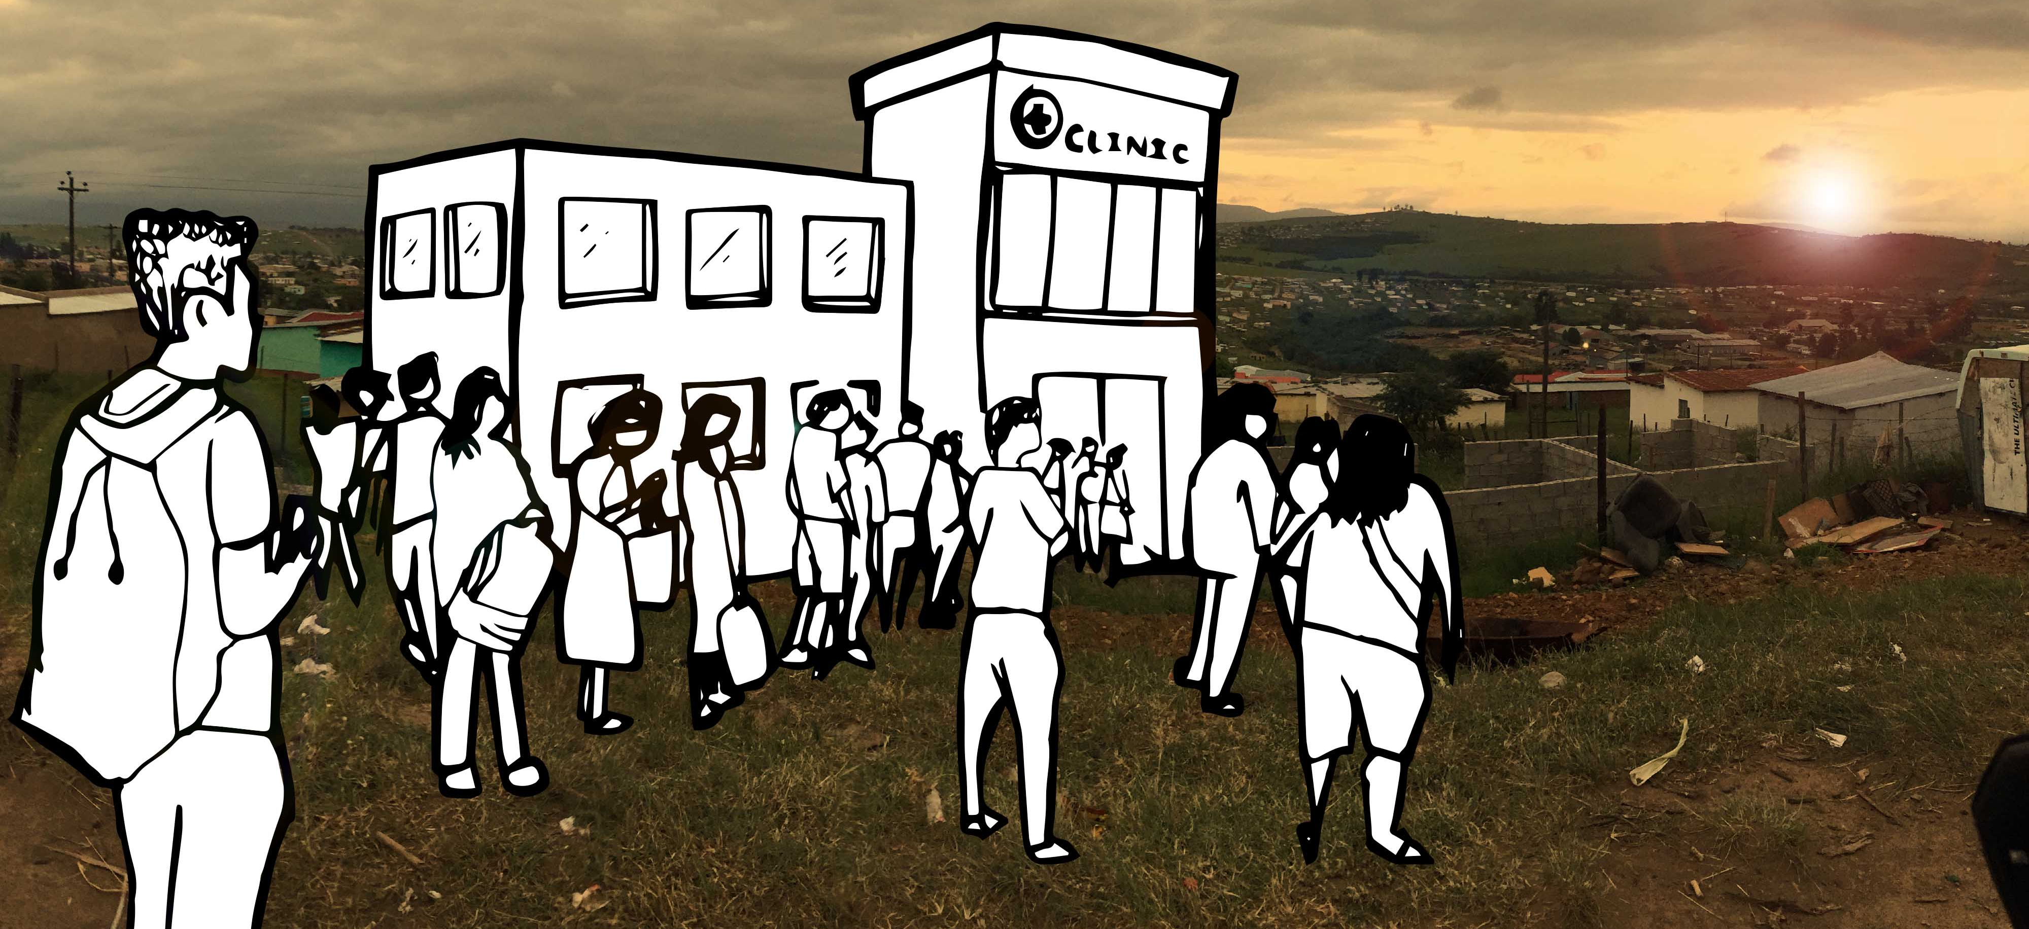
Redesigning our health system response
Clinic-based service delivery model will not achieve our goals
e.g. ESA
5.2 million new ART initiations
>14 million VLS
Notes:
In an epidemic that affects relatively healthy people, why ask them to go to facilities that that they know are full of genuinely sick people; facilities that cannot accommodate them (poor infrastructure), that do not have staff who are competent to deal with HIV and TB, and aren’t enthusiastic about dealing with the complex and diverse needs of people living with HIV and TB (institutionalised stigma), and then the facilities’ make them sick (lack of adequate infection control)…and we wonder why these patients do not return.

Slide 19
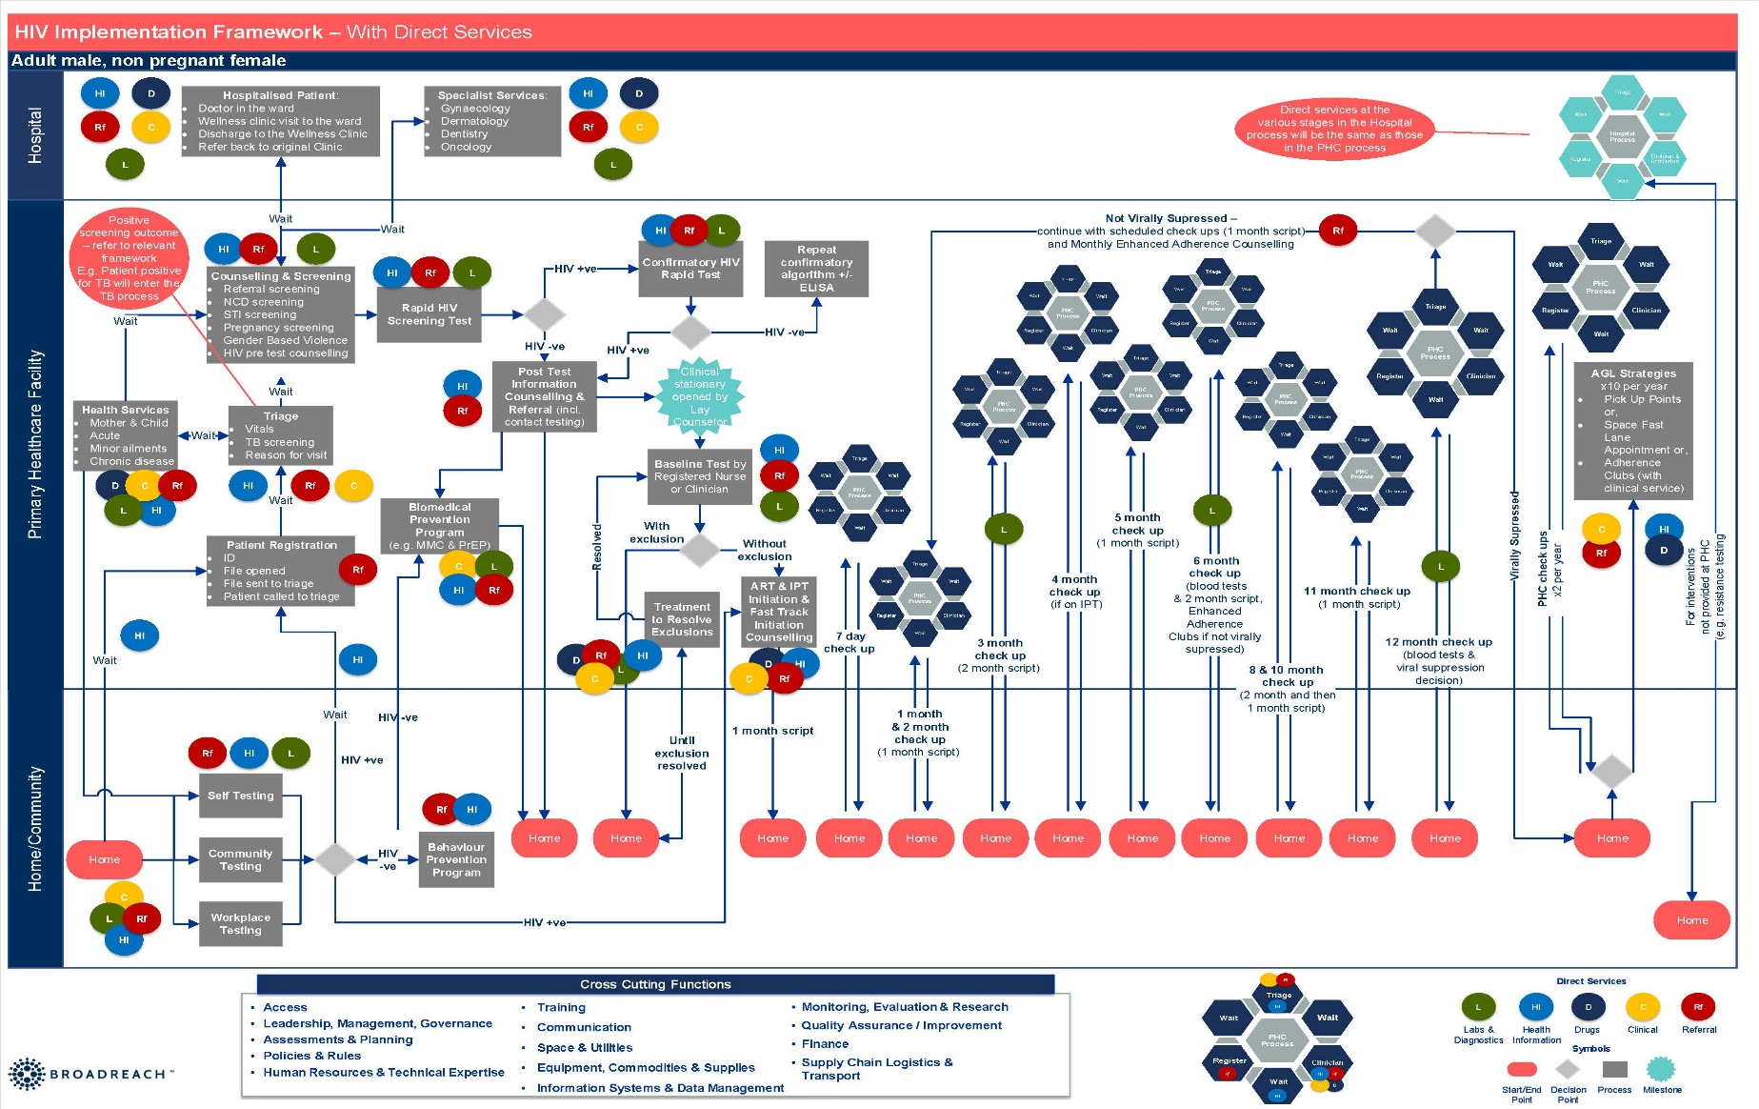
A patient journey through the health system
Darko, personal communication, 2019

Slide 20
A patient journey through the health systems
Newly diagnosed Adult Male with Uncomplicated HIV with no Co-Morbidities
Interventions/Interactions | Approximate Quantity or Duration
Direct interventions-Home to “File Open” | 25-30
Additional direct interventions to 12 months VL suppressed | 108
Round trips to health facility in 12 months | 13
First visit number of queues to wait in | 7-8
Flow up visits number of queues to wait in over 12 months | 36-48
Average time of first queue to collect file* | 3-4 hrs (39-42 hrs/yr)
Darko, personal communication, 2019
Notes:
There can be no reasonable expectation that any person could sustain this burden of interactions and waiting times on an ongoing life-time basis with current service delivery models
The largest opportunities for simplification of the implementation framework can be obtained if:
A model of home care can be operationalized at scale to radically reduce required clinic visits
The number of required interventions between discovery of positivity and the opening of a clinical file can be radically reduced; and
The initial time patients spend waiting to find their file prior to being sent to triage is radically reduced

Slide 21

Re-designing health system delivery models
Personalised Home Based & Community Services
Up-referral
Primary Health Care Clinics
Down-referral
Hospitals
Notes:
If we are to initiate an additional 5.2 million people on ART and keep >14million virally suppressed in ESA, current service delivery models that are clinic focused will not be able to cope with the increasing demand.
We have to reconfigure new ways of doing things.
We are moving in the right direction, we just need to move faster.

Slide 22
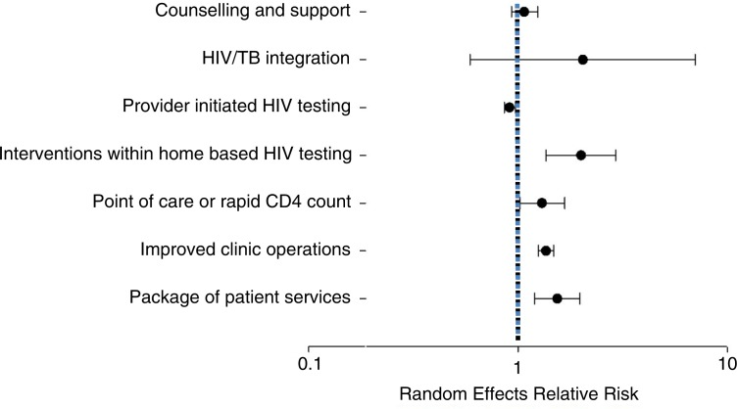
2016
The literature on interventions to increase uptake of ART is limited and of mixed quality.
More implementation research and evaluation is needed to identify how best to offer treatment initiation in a manner that is both efficient for service providers and effective for patients without jeopardizing treatment outcomes.
Notes:
We identified 22 studies, which evaluated 25 interventions and included data on 45,393 individual patients. Twelve of twenty-two studies were observational. Rapid/point-of-care (POC) CD4 count technology (seven interventions) (relative risk, RR: 1.26; 95% confidence interval, CI: 1.021.55), interventions within home-based testing (two interventions) (RR: 2.00; 95% CI: 1.362.92), improved clinic operations (three interventions) (RR: 1.36; 95% CI: 1.251.48) and a package of patientdirected services (three interventions) (RR: 1.54; 95% CI: 1.201.97) were all associated with increased ART initiation as was HIV/ TB service integration (three interventions) (RR: 2.05; 95% CI: 0.597.09) but with high imprecision. Provider-initiated testing (three interventions) was associated with reduced ART initiation (RR: 0.91; 95% CI: 0.860.97). Counselling and support interventions (two interventions) (RR 1.08; 95% CI: 0.941.26) had no impact on ART initiation. Overall, the evidence was graded as low or moderate quality using the GRADE criteria. Conclusions: The literature on interventions to increase uptake of ART is limited and of mixed quality. POC CD4 count and improving clinic operations show promise. More implementation research and evaluation is needed to identify how best to offer treatment initiation in a manner that is both efficient for service providers and effective for patients without jeopardizing treatment outcomes.

Slide 23
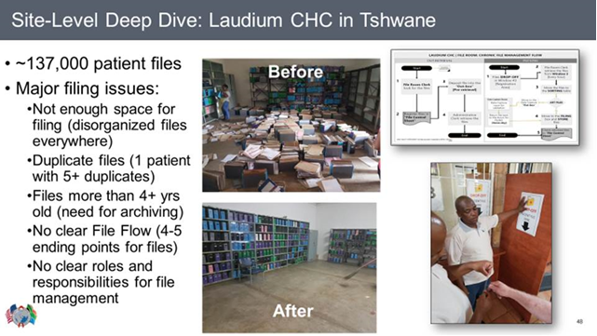
Improved filing reduces waiting times
Community health centre, South Africa
Waiting times reduced from > 4 hours to 1 hour

Slide 24
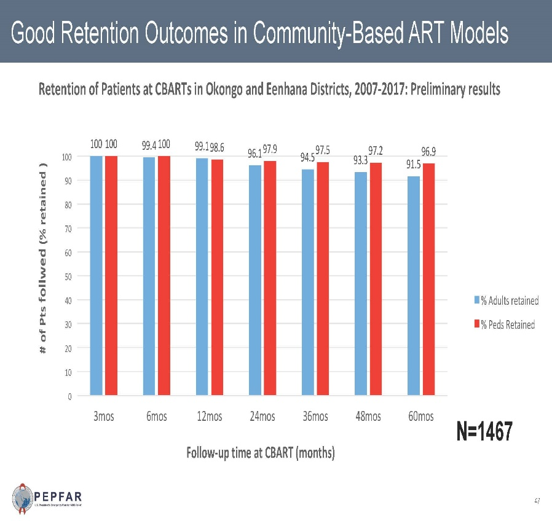
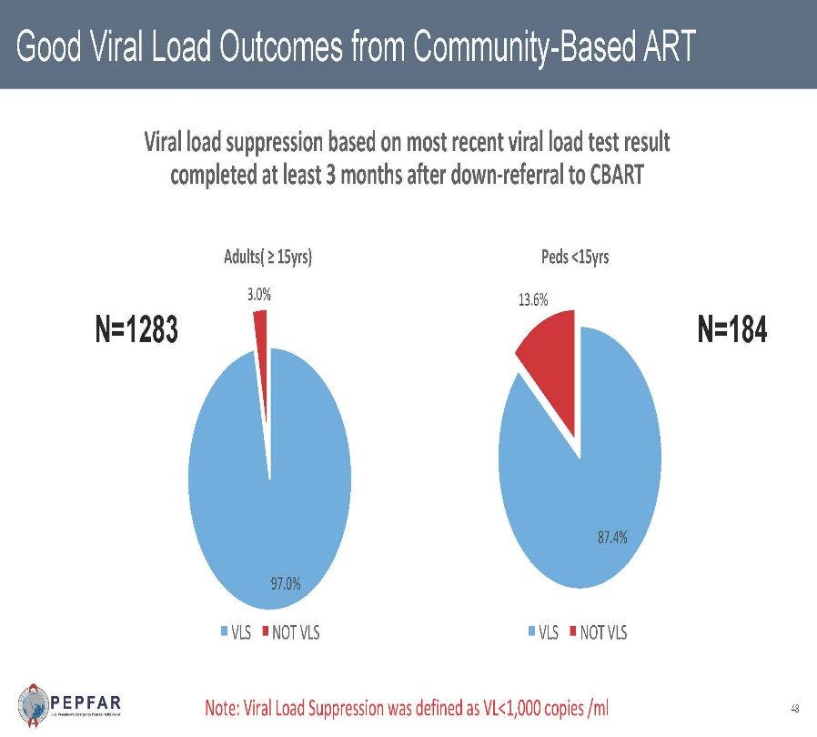
Community ART: the experience of Namibia
Successes with Community-based…
Taking service delivery back to communities to reach the last 90!
Source: PEPFAR COP19 Outbrief - Namibia

Slide 25
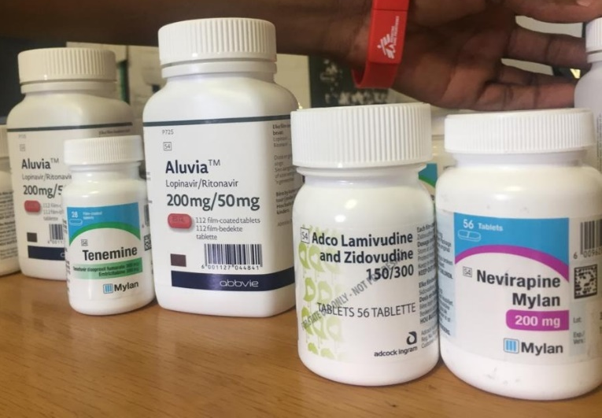

Multi-scripting: 6 months non-inferior to two months
Retention and viral load outcomes from a cluster randomized trial comparing extending Adherence Club ART refill dispensing intervals from 2 to 6 monthly.
Keitumetse Lebelo¹, Tali Cassidy^{1,2}, Sibusiso Ndlovu¹, Helen Hayes³, Catherine Orrell^{4,5}, Anna Grimsrud⁶, Claire Keene¹, Nompumelelo Zokufa¹, Tabitha Mutseyekwa¹, Jacqueline Voget³, Rodd Gerstenhaber¹, Lynne Wilkinson⁷
CONCLUSION:
At 12 months, no appreciable difference in outcomes between AC patients receiving SOC or 6-month refills
Source: Lebelo, SA AIDS 2019

Slide 26

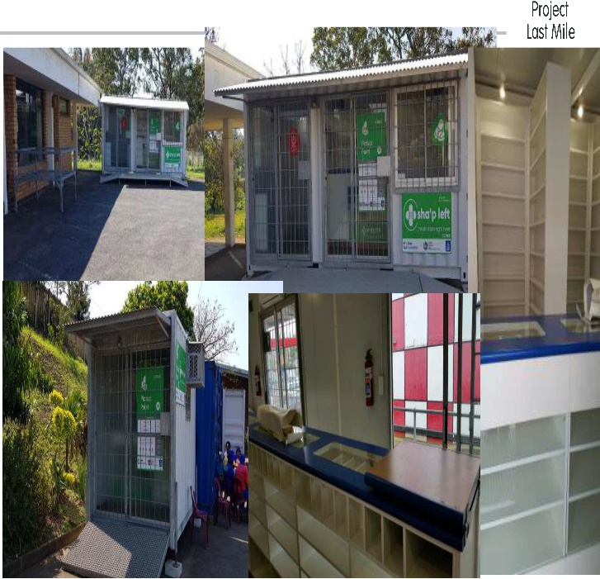
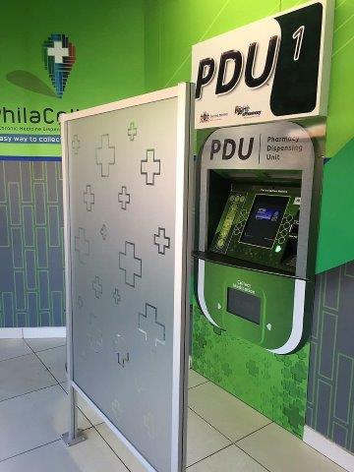
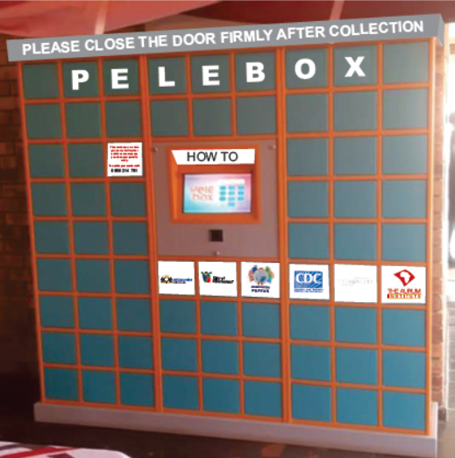
Taking ART re-supply out of the clinic
Local challenges can be solved by local entrepreneurs
Automated medicine dispensing machines - prototypes
Image Sources: Aurum Research Institute, Project Last Mile, Right to Care - SA

Slide 27
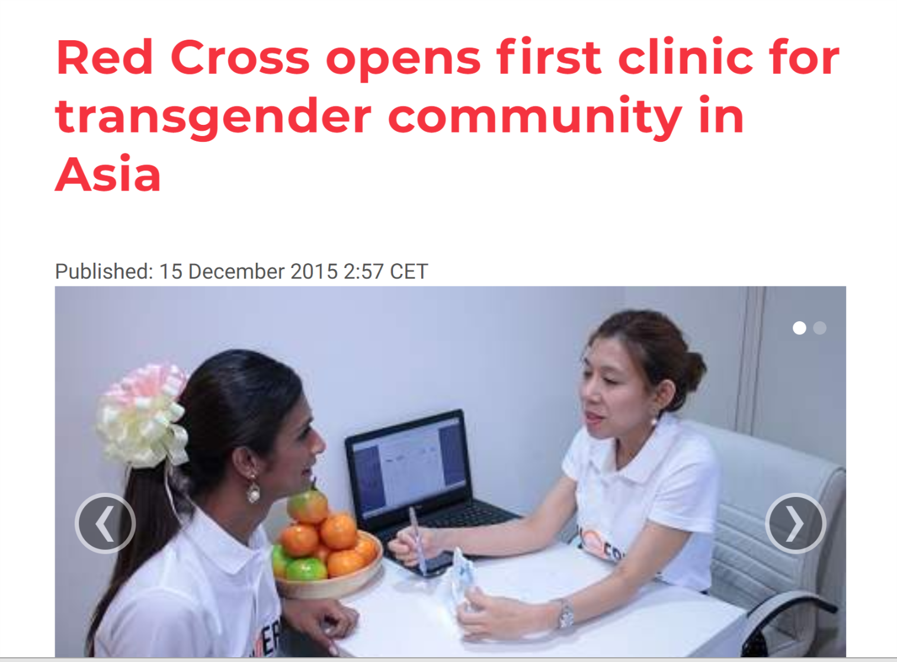
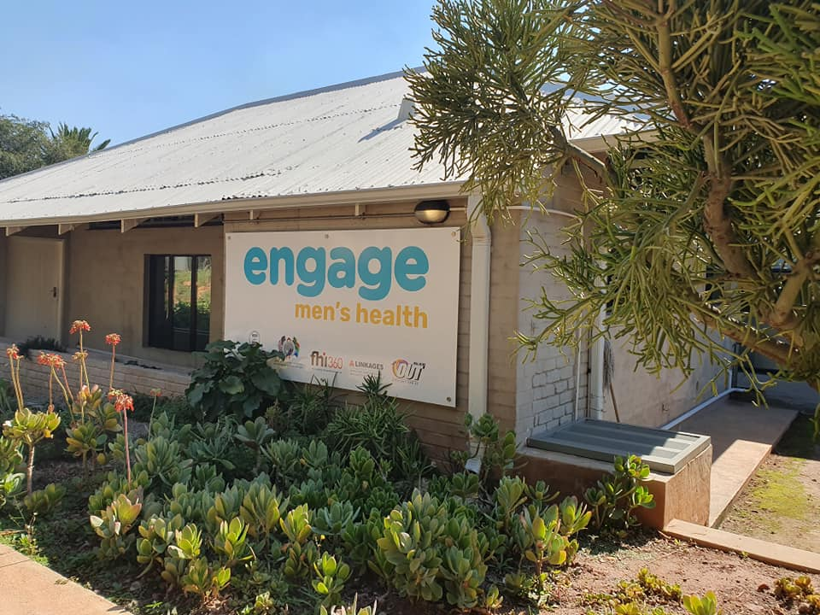

Key population-led integrated health services
.
.
Source: Engage Mens Health, Anova Health, SA

Slide 28
Optimising geographical targeting to maximise precision programming
2017 HIV prevalence in persons ages 15-49, administrative subunit level
Change in HIV prevalence between 2000-2017
Dwyer-Lindren Nature 2019

Slide 29

Community mobilisation
Outreach testing
Community health agents
Lay counsellors
Community ART groups
Community adherence clubs
Global UNAIDS report 2019

Slide 30
Combination treatment and prevention:
Scale up of ART and VMMC: HIV incidence in Rakai
Gabrowski et al. NEJM 2017

Slide 31

Achieving the 3rd 90: what will it take?
A people-centred response that is participatory and empowering
Use cascades to identify gaps and target interventions in areas of greatest unmet need
Recognise the need to reconfigure our health systems by shifting to community-based models
Scale innovations that enhance patient engagement and convenience
Maximise differentiated models of care and integrated approaches to achieve coverage
Work with communities and civil society to generate demand for quality services and tackle stigmas and discrimination
Combination approaches are essential to increase ART coverage and reduce HIV incidence

Slide 32
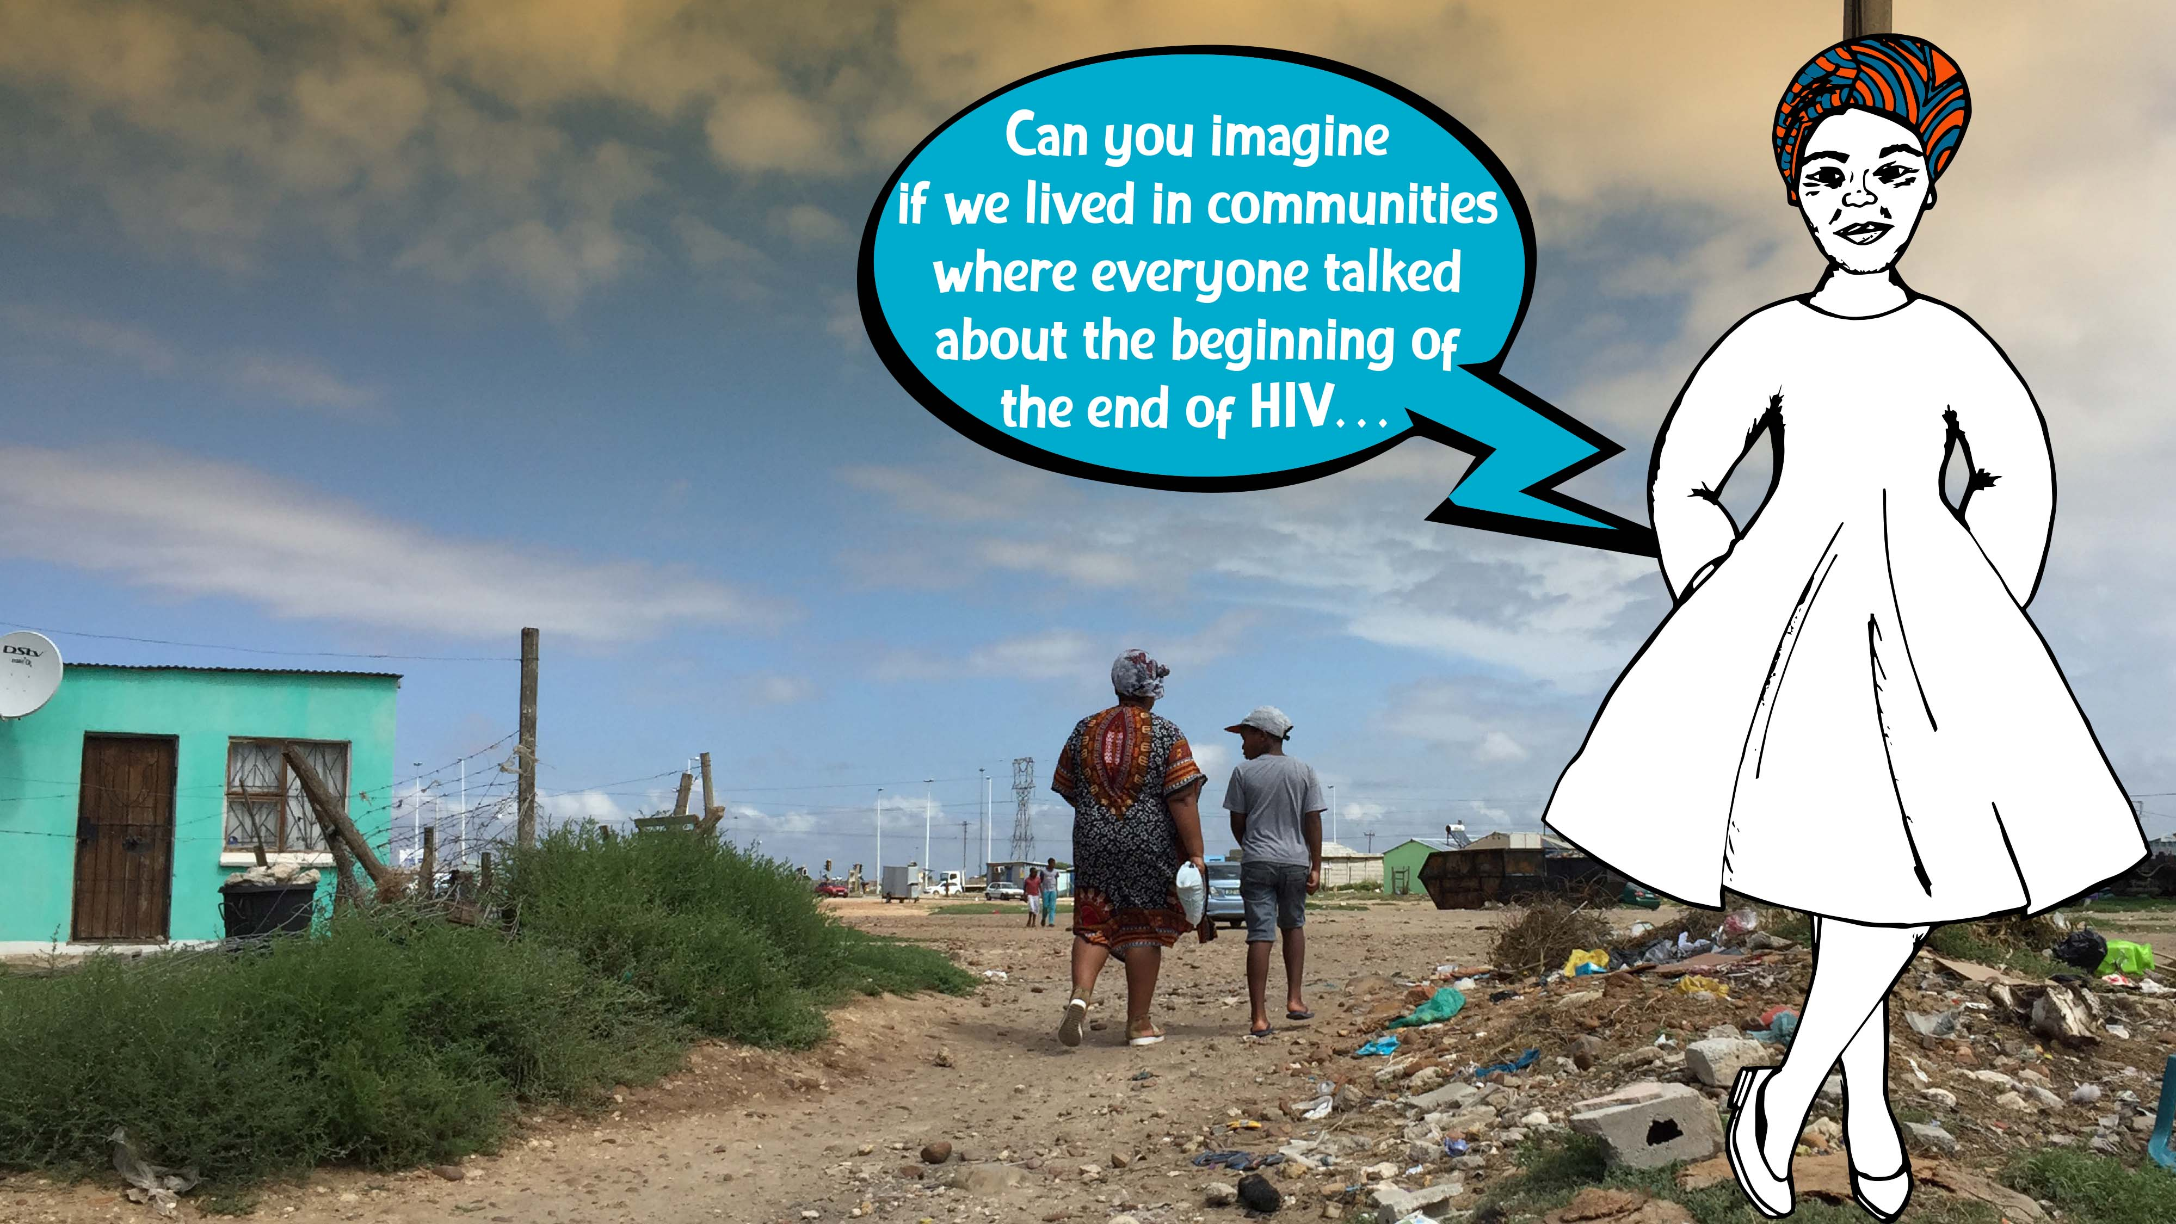

Slide 33



Acknowledgements
Wits RHI:
Helen Rees
Sinead Delany-Moretlwe
Francois Venter
Matthew Chersich
John Imrie
Lee Fairlie
Saiqa Mullick
Mohammed Majam
Naomi Hill
Elmari Briedenhann
Ricardo Subramoney
Partners and collaborators
Wafaa El-Sadr, Columbia University/HPTN
Charlotte Watts, DFID
Keitumetse Lebelo, MSF
Yogan Pillay, Department of Health, SA
Romy Overmeyer, Department of Health, SA
Izukanji Sikazwe , Lusaka, Zambia
Ernest Darko, BroadReach, SA
Dino Rech, Aurum Research Institute, SA
James MacIntyre – Anova Health, SA
Ian Sanne, Right to Care, SA
Anele Yawa, TAC
Cobus Olivier, CDC
Alet Bosman –FPD/Dira Sengwe Secretariat – SAAIDS
Kim Marsh – UNAIDS
Dr Gloria Maimela
+27 (0) 72 528 0727 | gmaimela@wrhi.ac.za

